Slide 1
The 1st International Workshop on Combinatorial Reconfiguration (CoRe 2015)
Polynomial-Time Algorithm for
Sliding Tokens on Trees
Erik D. Demaine
MIT, USA
Martin L. Demaine
MIT, USA
Eli Fox-Epstein
Brown University, USA
Duc A. Hoang
JAIST, Japan
Takehiro Ito
Tohoku University, Japan
Hirotaka Ono
Kyushu University, Japan
Ryuhei Uehara
JAIST, Japan
Yota Otachi
JAIST, Japan
Takeshi Yamada
JAIST, Japan
February 18, 2015

Slide 2
Reconfiguration Problems
The problem arises when we want to find a step-by-step transformation between two feasible solutions of a problem using some given reconfiguration rules such that all intermediate results are also feasible.
Many kind of reconfiguration problems have been studied recently, including the independent set reconfiguration problem (ISRECONF).
van den Heuvel, J.: The complexity of change. Surveys in Combinatorics 2013,
London Mathematical Society Lecture Notes Series 409 (2013)

Slide 3
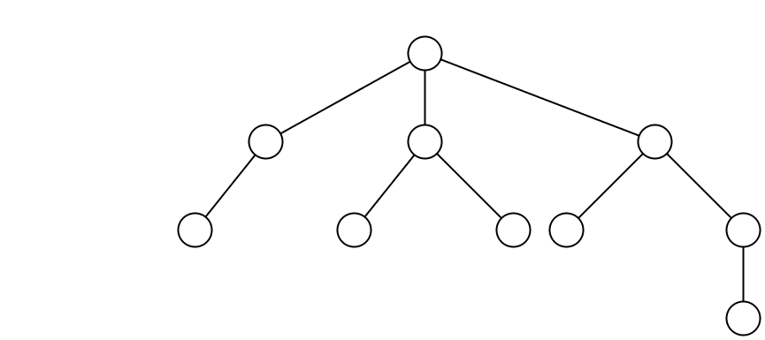
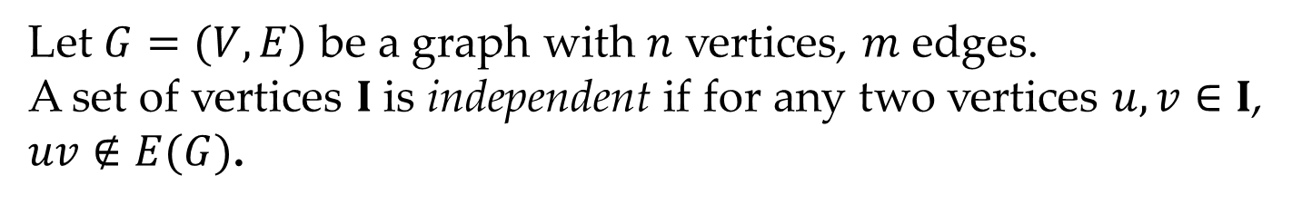
Independent set
Let $G=(V,E)$ be a graph with $n$ vertices, $m$ edges.
A set of vertices $I$ is independent if for any two vertices $u, v∈I$, $uv∉E(G)$.
An independent set
Not an independent set

Slide 4
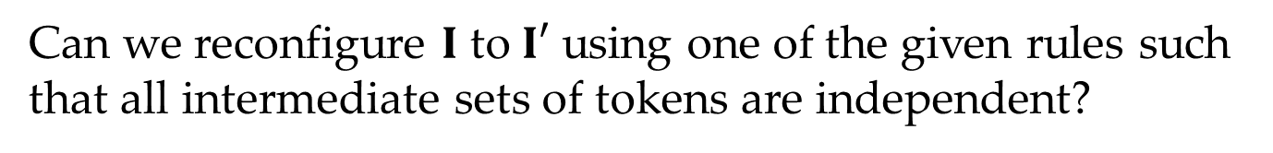
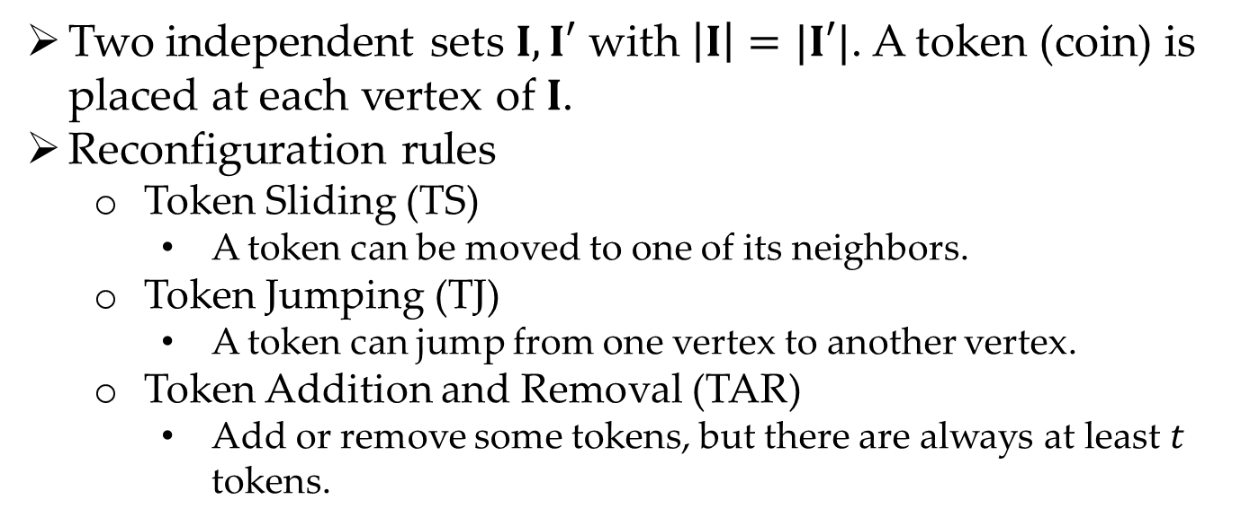
Independent set reconfiguration problem (ISRECONF)
GIVEN
Two independent sets $I, I′$ with $\left|I\right|=|I′|$. A token (coin) is placed at each vertex of $I$.
Reconfiguration rules
Token Sliding (TS)
A token can be moved to one of its neighbors.
Token Jumping (TJ)
A token can jump from one vertex to another vertex.
Token Addition and Removal (TAR)
Add or remove some tokens, but there are always at least $t$ tokens.
PROBLEM
Can we reconfigure $I$ to $I′$ using one of the given rules such that all intermediate sets of tokens are independent?

Slide 5
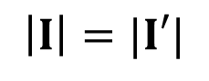
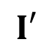

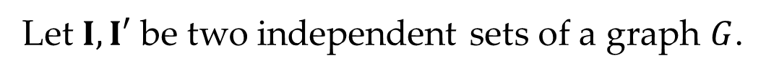

ISRECONF under TS rule
Let $I, I′$ be two independent sets of a graph $G$.
$$I$$
$$I′$$
$$\left|I\right|=|I′|$$
YES (why?)
Question: Can we reconfigure $I$ to $I′$ using TS rule such that all intermediate sets of tokens are independent?

Slide 6

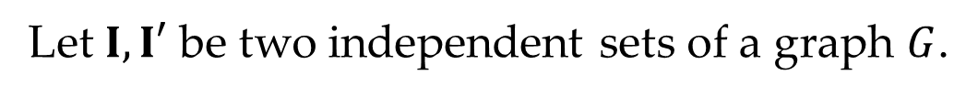
ISRECONF under TS rule
Let $I, I′$ be two independent sets of a graph $G$.
$$I$$
$$I′$$
$$\left|I\right|=|I′|$$
NO (why?)
Question: Can we reconfigure $I$ to $I′$ using TS rule such that all intermediate sets of tokens are independent?

Slide 7
ISRECONF under TS rule
PSPACE-complete
Polynomial
general
Ito et. al. (2011)
Open
A
B
B is a subclass of A
perfect
Kaminski et. al. (2012)
planar
Hearn and Demaine (2005)
chordal
bipartite
distance-hereditary (D.H)
interval
Ptolemaic
bipartite D.H.
trivially perfect
proper interval
block
Demaine et. al. (2014)
tree
Presented @ ISAAC 2014

Slide 8
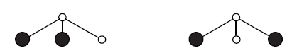
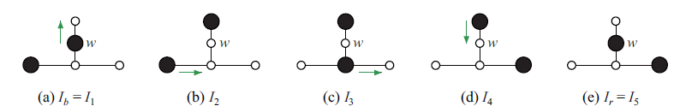
Why study the problem for trees?
M. Kaminski, P. Medvedev, and M. Milanic(2012) gave a linear time algorithm for even-hole-free graphs (tree is a subclass of this graph class) under TJ and TAR rules.
The answer is always YES.
Tokens never make detours.
Not for TS rule.

Slide 9
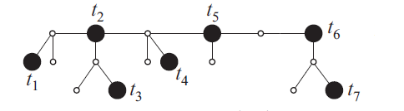
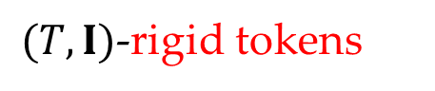
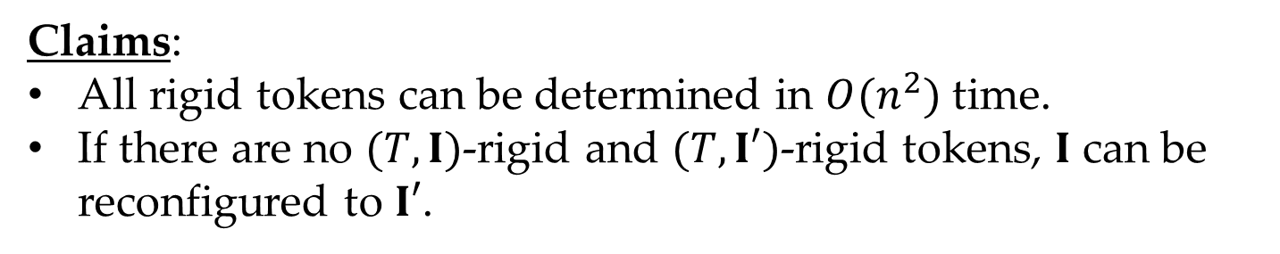
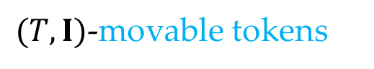
Key concept – Rigid tokens
Intuitively, a token $u$ is rigid if there is no way to slide $u$.
$(T, I)$-rigid tokens
$(T,I)$-movable tokens
Claims:
All rigid tokens can be determined in $O(n^{2})$ time.
If there are no $(T,I)$-rigid and $(T,I′)$-rigid tokens, $I$ can be reconfigured to $I′$.

Slide 10
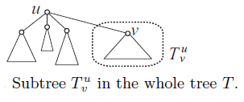
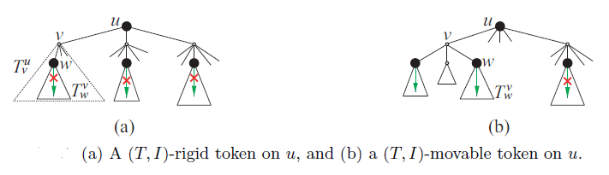
Determine if a token is rigid

Slide 11
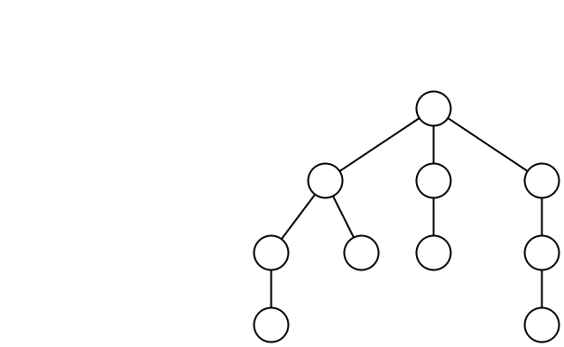
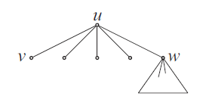
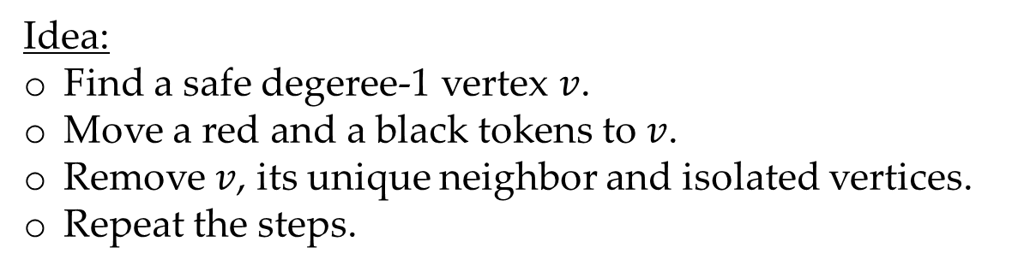
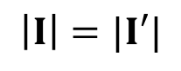
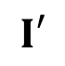

Reconfigure non-rigid tokens
Let $I, I′$ be two independent sets of a graph $G$.
$$I$$
$$I′$$
$$\left|I\right|=|I′|$$
?
Order of sliding.
Detour.
Idea:
Find a safe degeree-1 vertex $v$.
Move a red and a black tokens to $v$.
Remove $v$, its unique neighbor and isolated vertices.
Repeat the steps.

Slide 12
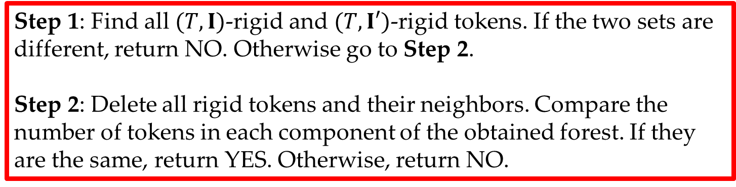
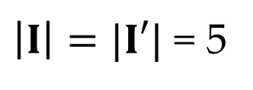
Polynomial-Time Algorithm
Step 1: Find all $(T, I)$-rigid and $(T,I′)$-rigid tokens. If the two sets are different, return NO. Otherwise go to Step 2.
Step 2: Delete all rigid tokens and their neighbors. Compare the number of tokens in each component of the obtained forest. If they are the same, return YES. Otherwise, return NO.
$$I$$
$$I′$$
$\left|I\right|=|I′|$ = 5
NO
YES

Slide 13
Open Problems
PSPACE-complete
Polynomial
general
Ito et. al. (2011)
Open
A
B
B is a subclass of A
P, NP or PSPACE?
perfect
Kaminski et. al. (2012)
planar
Hearn and Demaine (2005)
chordal
bipartite
distance-hereditary (D.H)
interval
Ptolemaic
bipartite D.H.
trivially perfect
proper interval
block
Demaine et. al. (2014)
tree

